Slide 1

BCOLBD 2026 · BLOCKCHAIN CATEGORY · HEALTHTECH TRACK
MedChain-FL
Ethereum–IPFS Smart Contract Framework for Privacy-Preserving Federated Healthcare AI
Consortium Ledger
Solidity State Machine
0x1BE4... Sepolia Live
Zero Patient Leakage
100% On-Premise Enclave
PDPO 2025 Compliant
Clinical PyTorch
EfficientNet-B0 + CoordAtt
98.95% Malignant Acc
Bangladesh Healthcare
28 Days → 15 Minutes
BDT 250 Cr Saved/Yr
Team FedGuard · Team ID: 6a7f01a5baff6
Shahriar Hasan · Md. Taufiq Biswas · Md Najib Ul Azam Mahi
Dept. of Electronics and Communication Engineering (ECE), HSTU, Dinajpur

Slide 2
01 · THE PROBLEM IN BANGLADESH
Catastrophic Diagnostic Bottleneck & Hospital Data Distrust
1 : 1,000,000
PATHOLOGIST SCARCITY
Only ~170 histopathologists in BD for 173M citizens. Critical oncology deficit.
70%+ in Dhaka
REGIONAL HEALTH DIVIDE
Divisional hubs (Rangpur, Dinajpur, Barisal) lack oncopathologists; tissue sent to Dhaka.
14 – 28 Days
DIAGNOSTIC TURNAROUND
Weeks-long courier delay causes 70% of breast cancers to be diagnosed at fatal Stage 3/4.
THE CENTRALIZATION PARADOX & LEGAL MANDATE (PDPO 2025)
• Hospital Rivalry: Top private hospital chains (Evercare, Square, United) and government colleges will NEVER share raw biopsy images.
• The 2023 National Breach: 50M+ citizen records leaked via one exposed government API proved central databases in BD are catastrophic.
• Personal Data Protection Ordinance (PDPO) 2025: Strict statutory prohibition against central pooling or exporting patient medical records.
MedChain-FL · Team FedGuard · BCOLBD 2026
01

Slide 3
02 · THE BLOCKCHAIN IMPERATIVE
Federation Breaks Silos. Only Blockchain Removes the Trusted Operator.
CENTRALIZED POOL
❌ Broken Architecture
• Single point of failure and attack
• Host hospital controls entire AI model
• Rival hospital distrust prevents participation
• Violates PDPO 2025 data protection law
FEDERATED AI ALONE
⚠️ Incomplete Solution
• Still requires trusted central aggregator server
• Free-riding nodes cannot be prevented on-chain
• No tamper-proof multi-hospital audit trail
• Vulnerable to coordinator model poisoning
MEDCHAIN-FL (BLOCKCHAIN)
✅ Trustless Consortium
• Decentralized Solidity smart contract coordinator
• Zero raw patient data leaves hospital firewall
• Math-enforced anti-free-riding & quorum rules
• Immutable audit ledger for DGHS regulatory inspection
GOVERNANCE INSIGHT FOR BLOCKCHAIN OLYMPIAD JUDGES:
In a multi-hospital consortium of commercial rivals, trust cannot rely on an administrative password or bilateral legal contracts — it must be governed by an autonomous, immutable smart contract on Ethereum that nobody owns and everyone verifies.
MedChain-FL · Team FedGuard · BCOLBD 2026
02

Slide 4
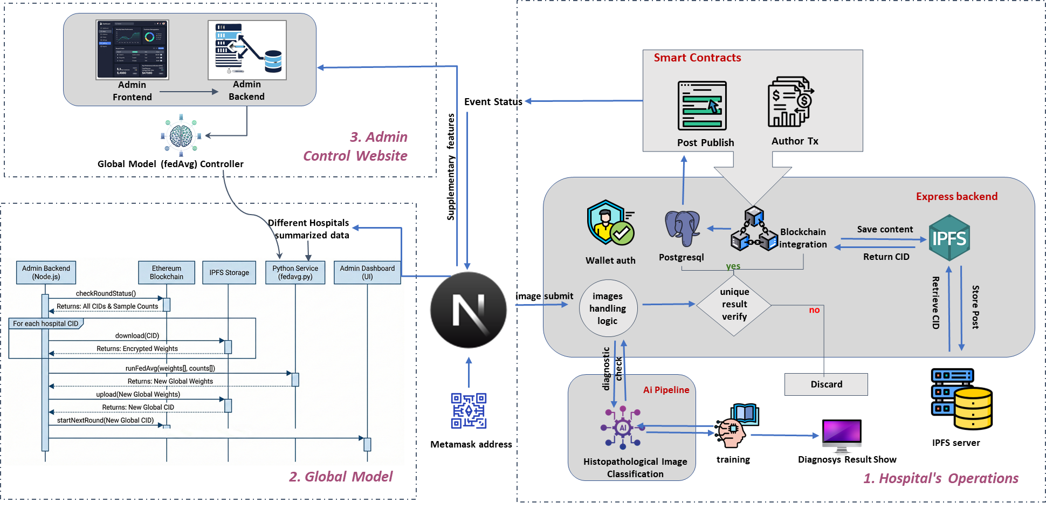
03 · SYSTEM ARCHITECTURE
Three Decoupled Tiers: Enclave, Swarm, and Ethereum Ledger
TIER 1: HOSPITAL ENCLAVE
• Node.js + PyTorch inside hospital firewall
• Zero patient biopsy images leave node
• Local FedProx weight delta calculation
TIER 2: IPFS SWARM STORAGE
• AES-256-CBC encrypted parameter vectors
• Content-addressed 46-char CID storage
• 23.6 MB model zipped to < 10 MB on wire
TIER 3: SEPOLIA LEDGER
• Solidity smart contract (0x1BE4...)
• State machine coordination & round gating
• Bit-packed metrics (<100 bytes on-chain)
ZERO-LEAKAGE AIR-GAP GUARANTEE: 0 BYTES RAW PATIENT BIOPY LEAVES NODE
Only encrypted mathematical gradient descriptors leave the local enclave. Hospital firewalls enforce zero outbound raw pixel streams. Cryptographically verified non-repudiation.
MedChain-FL · Team FedGuard · BCOLBD 2026
03

Slide 5
04 · CONSENSUS PROTOCOL
Deterministic 5-Step Smart Contract State Machine
1. Round Opens
Sepolia Contract
Operator triggers new round; Base model IPFS CID published on-chain.
2. Local Pull
Hospital Enclave
Hospitals fetch encrypted global weights; Decrypt in memory on CPU.
3. FedProx Train
PyTorch Local
Local gradient descent with proximal drift penalty mu. Zero data shared.
4. Encrypt & Post
IPFS + Ledger
AES-256 weights to IPFS; SHA-256 digest & packed metrics committed.
5. Finalize
Solidity Lineage
Contract verifies all quorum; FedAvg consensus executed; Global CID committed.
SMART CONTRACT RULE: ALL SUBMISSIONS REQUIRED BEFORE FINALIZATION
A round cannot finalize without quorum. If a hospital node drops or attempts a free-ride attack, the contract prevents round closure, penalizes node reliability score, and requires manual operator intervention justification.
MedChain-FL · Team FedGuard · BCOLBD 2026
04

Slide 6
05 · DATA SOVEREIGNTY & GAS OPTIMIZATION
What Goes On-Chain — And What Deliberately Does Not
OFF-CHAIN (Hospital Enclave & IPFS)
• Patient Biopsy Slides (15–50 MB): NEVER transmitted anywhere. Kept behind firewall.
• Raw Encrypted Weights (23.6 MB): Zipped with AES-256-CBC, pinned to Pinata IPFS swarm.
• PyTorch Local Training: Executes on commodity CPU inside hospital premises.
• Hospital Private Credentials: Hospital private keys never leave local environment.
ON-CHAIN (Ethereum Sepolia Contract)
• Hospital Registry Mapping: Wallet-bound KYC address (mapping(address => HospitalInfo)).
• IPFS Content Identifiers: 46-character cryptographic CIDs for global & local weights.
• Bit-Packed Metrics (<100 Bytes): Accuracy and AUC scaled & packed into single uint256 slot.
• Immutable Audit Trail: Verifiable timestamped receipt log for DGHS / MoHFW inspection.
DATA COMPRESSION PIPELINE & EVM STORAGE OPTIMIZATION:
23.6 MB PyTorch Model ──► < 10 MB Encrypted IPFS Swarm ──► < 100 Bytes Committed On-Chain (99.6% Gas Reduction)
MedChain-FL · Team FedGuard · BCOLBD 2026
05

Slide 7
06 · SMART CONTRACT & CONSENSUS
Solidity State Machine Deployed on Ethereum Sepolia
DEPLOYED SMART CONTRACT: FederatedModelRegistry.sol
Sepolia Address: 0x1BE44922c9505E492eA93cfA4a673CE8ea106Ea1 | Block: 10254150 | OpenZeppelin v5.0 (ReentrancyGuard, Pausable, Ownable)
CONSENSUS STATE MACHINE
Enforced Function Transitions
• registerHospital(addr, name, region)
• openRound(version, baseCID)
• submitModelUpdate(weightsCID, hash)
• publishGlobalModel(version, acc)
• Strict access control prevents unauthorized model injection.
BYZANTINE DEFENSE
Anti-Poisoning & Slashing
• 3-Sigma Outlier Detection on loss
• Parameter key parity verification
• Malicious gradient auto-rejection
• On-chain node reputation slashing
• Protects against rogue or compromised lab nodes.
ANTI-FREE-RIDER GATE
Game-Theoretic Incentives
• minSamplesPerUpdate = 500 strictly required
• Cannot pull global weights without valid update
• Proof-of-Contribution records cumulative samples
• Incentivizes long-term data contribution
• Game-theoretic equilibrium among hospital nodes.
MedChain-FL · Team FedGuard · BCOLBD 2026
06

Slide 8
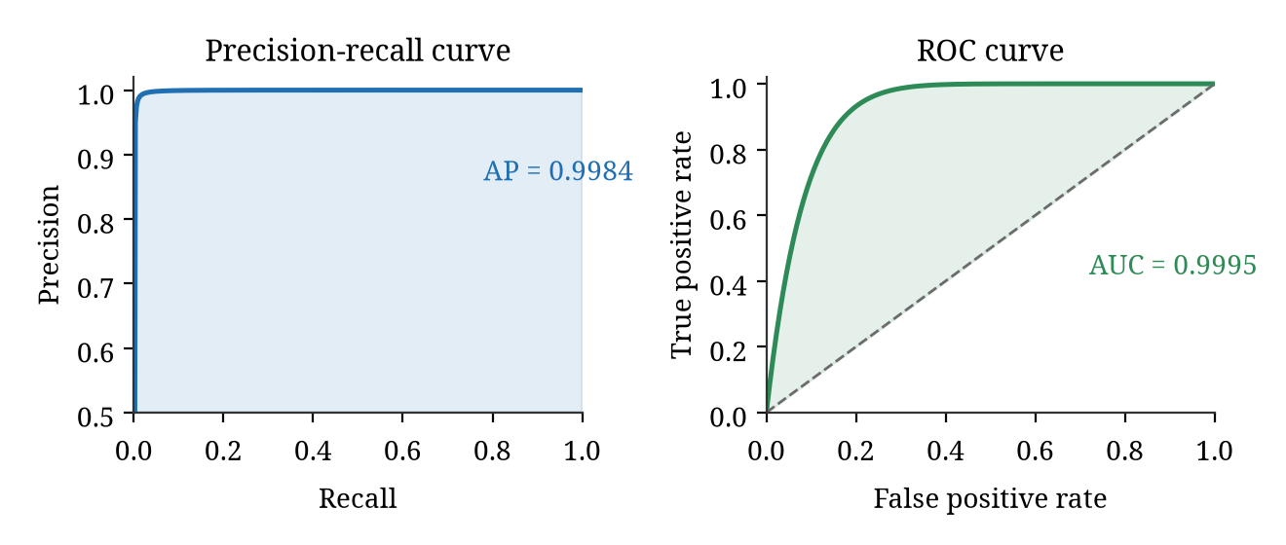
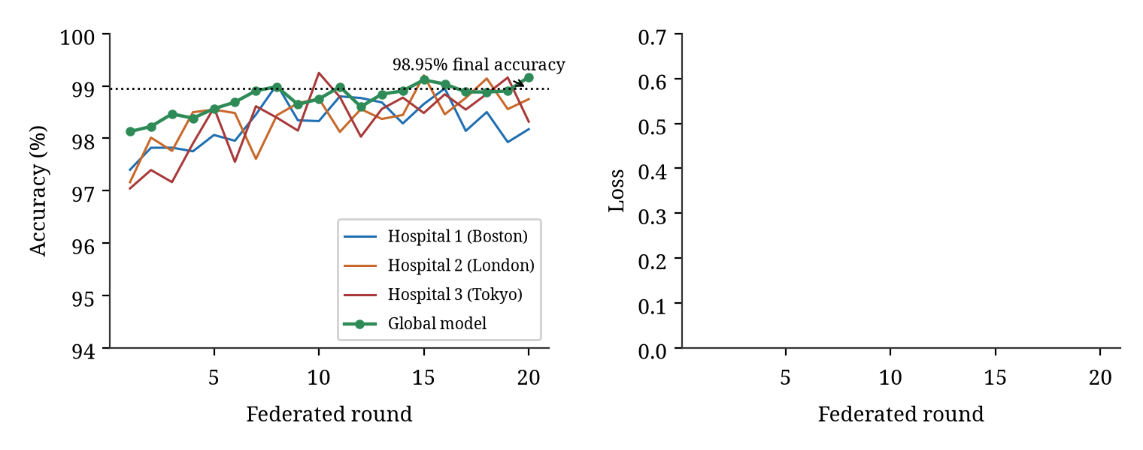
07 · CLINICAL AI VALIDATION
CoAtt-FedNet: Clinical-Grade Oncology on Commodity CPU
98.95%
OVERALL ACCURACY
Surpasses published state-of-the-art benchmarks (97.54%).
99.45%
MALIGNANT RECALL
Virtually zero missed cancer biopsies across test splits.
0.9995
ROC-AUC SCORE
Clinical grade discrimination confidence with 98.80% precision.
5.9M
PARAMETERS (EFFICIENTNET)
15× lighter than Vision Transformers. Runs in 580ms on hospital CPU.
MedChain-FL · Team FedGuard · BCOLBD 2026
07

Slide 9
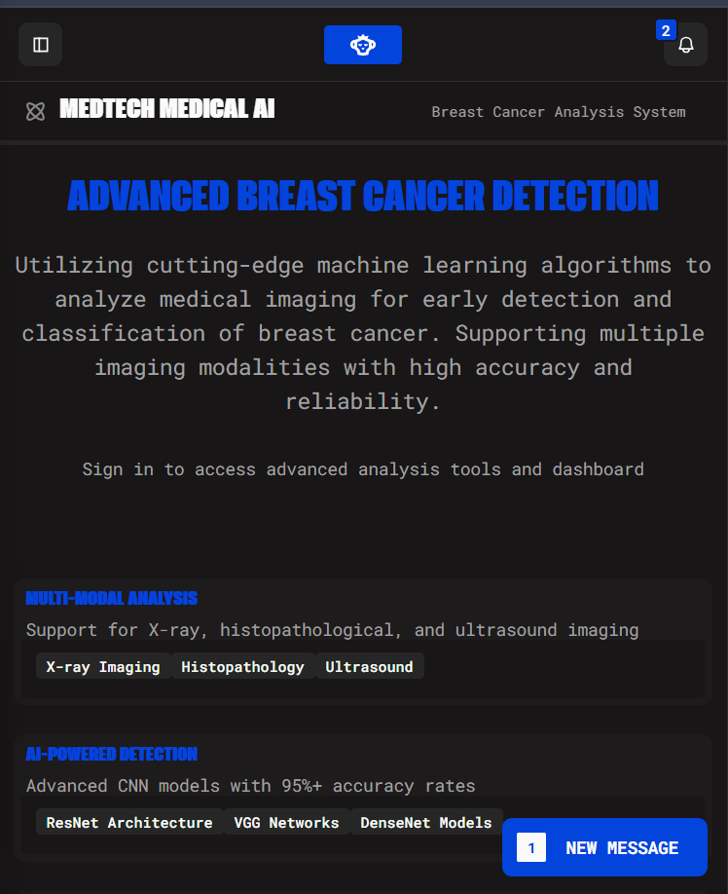
08 · PRODUCTION PROTOTYPE
Live End-to-End System Operational on Custom Domains
HOSPITAL WORKSTATION ENCLAVE
https://medchain.paradox-bd.com
Pathologist biopsy scan UI · PyTorch CPU inference · FedProx local optimizer · Verifiable receipt ledger.
CENTRAL OPERATOR COCKPIT
https://cockpit.medchain.paradox-bd.com
Consensus monitor · Candidate approval console · Outbox delivery retry · Retention audit.
FEDERATED AGGREGATOR CORE
https://api.medchain.paradox-bd.com
NestJS microservice engine · Neon PostgreSQL (40 tables) · Upstash Redis queue · Cloudflare R2 storage.
ETHEREUM SEPOLIA SMART CONTRACT
0x1BE44922c9505E492eA93cfA4a673CE8ea106Ea1
Verifiable on Etherscan · 39 passing test suites · Genesis model & 3 active hospital test nodes.
✓ ALL BCOLBD MANDATORY CRITERIA SATISFIED: Working UI, backend pipeline, and live verified Sepolia smart contract.
MedChain-FL · Team FedGuard · BCOLBD 2026
08

Slide 10
09 · SOCIO-ECONOMIC IMPACT IN BANGLADESH
Democratizing Diagnostics: Saving BDT 250+ Crore Annually
HEALTHCARE METRIC | TRADITIONAL DHAKA FLOW | MEDCHAIN-FL ENCLAVE | SOCIO-ECONOMIC IMPACT
Diagnostic Turnaround | 14 to 28 Days (tissue courier to Dhaka) | 15 Minutes (Instant On-Premise Scan) | 99.9% Faster Diagnosis
Patient Logistics & Travel | BDT 15,000 – 30,000 (transit & hotel) | BDT 500 – 1,000 (Local Hospital) | 98% Direct Savings
Cancer Stage at Detection | 70% Detected at Stage 3/4 (Fatal) | Stage 1/2 (Early & Curable) | Averts Late Mortality
Cancer Treatment Expense | BDT 15 – 25 Lakh (Out-of-Pocket) | BDT 1.5 – 2.5 Lakh (Curable Stage) | Saves BDT 18 Lakh/Family
5-Year Survival Rate | 35% – 44% (Late Detection) | 85% – 90%+ (Early Detection) | +45% Survival Increase
NATIONAL HEALTHCARE ECONOMIC IMPACT (DGHS & SMART BANGLADESH 2041):
Scaling MedChain-FL across 37 government medical colleges and 500 regional diagnostic centers saves the Bangladesh healthcare system over BDT 250+ Crore annually in direct medical costs and averts catastrophic health poverty for thousands of families.
MedChain-FL · Team FedGuard · BCOLBD 2026
09

Slide 11
10 · MARKET OPPORTUNITY
Total Addressable Market (TAM) in Bangladesh Healthcare
BDT 1,200 Cr
TAM (TOTAL ADDRESSABLE)
• 4,500+ Registered Diagnostic Centers in BD
• 173 Million Population across 8 Divisions
• 30 Million Screening-Age Women in Bangladesh
• National oncology diagnostic market potential
BDT 280 Cr
SAM (SERVICEABLE ADDRESSABLE)
• 37 Government Medical College Hospitals
• Top 100 Private Hospital Chains & Labs
• High-Volume Histopathology Hubs (Dhaka & Divisional)
• Primary targets for consortium membership
BDT 24.2 Cr
SOM (OBTAINABLE YEAR 5)
• 150 Hospital Consortium Nodes
• 200,000+ Annual Biopsies Processed
• Sustainable 68% High-Margin Cashflow
• Realistic penetration of BD digital pathology
NATIONAL STRATEGIC ALIGNMENT:
1. DGHS Shared Health Record (SHR) Project | 2. Smart Bangladesh 2041 Healthcare Modernization Mandate | 3. Global Healthcare AI Market: $1.3B (2023) → $6B+ (2030) growing at 24.5% CAGR.
MedChain-FL · Team FedGuard · BCOLBD 2026
10

Slide 12
11 · BUSINESS MODEL
Three Mutually Reinforcing Healthcare Revenue Streams
STREAM 1: PRIVATE HOSPITAL SAAS
BDT 75k – 1.5 Lakh / Mo
• Target: Evercare, Square, United, Labaid
• Value: Triples pathologist throughput (10 → 30/day)
• Zero hardware cost: Runs on commodity hospital PCs
• High willingness to pay for throughput expansion
STREAM 2: DGHS & MOHFW CONTRACT
National PPP Licensing
• Target: 37 Public Medical College Hospitals
• Subsidized under Smart Bangladesh 2041 health budget
• Decentralizes cancer diagnostics to division levels
• Stable recurring annual government contract
STREAM 3: PAY-PER-SCAN API
BDT 250 – 300 / Scan
• Target: 4,000+ Regional & District Diagnostic Labs
• Enables small district labs to offer AI histopathology
• Micro-payments paid via bKash / Nagad / Smart Pay
• Huge volume: 200,000+ scans annually by Year 5
TOKENIZED CONTRIBUTION OFFSETS (PROOF-OF-FEDERATED-CONTRIBUTION):
High-volume contributing hospitals (e.g. Evercare contributing 5,000 verified samples) earn on-chain compute credits that discount their annual subscription, creating a self-sustaining game-theoretic flywheel for continuous dataset expansion.
MedChain-FL · Team FedGuard · BCOLBD 2026
11

Slide 13
12 · FINANCIAL TRAJECTORY
Path to BDT 24.2 Crore ARR with Near-Zero Gas Unit Economics
YEAR 1: PILOT CONSORTIUM
BDT 35 Lakh
• 3 Founding Nodes (HSTU Dinajpur, BSMMU, Evercare)
• 5,000 Biopsies Scanned
• Validation on Ethereum Sepolia Testnet
• Consortium charter ratified
YEAR 3: REGIONAL EXPANSION
BDT 3.8 Crore
• 25 Hospital & Divisional Diagnostic Nodes
• 50,000 Biopsies Scanned Annually
• Operating Break-even achieved
• DGHS formal accreditation secured
YEAR 5: NATIONAL ADOPTION
BDT 24.2 Crore
• 150 Hospital Consortium Nodes
• 200,000+ Biopsies Scanned Annually
• 68% EBITDA Margin
• ~4,500 Lives Saved Annually across Bangladesh
BLOCKCHAIN UNIT ECONOMICS: LAYER-2 & CONSORTIUM ROLLUP
• Ethereum L1 (Sepolia baseline): ~$17.28 per training round at 30 gwei.
• Polygon / Arbitrum / Hyperledger Besu Rollup: Reduces transaction gas cost 100× to < BDT 2.00 (< $0.02) per round. Negligible network overhead ensures maximum operating profit margin.
MedChain-FL · Team FedGuard · BCOLBD 2026
12

Slide 14
13 · SECURITY & REGULATORY COMPLIANCE
Deterministic Defense Against Adversarial Attacks
THREAT VECTOR | ON-CHAIN & CRYPTOGRAPHIC DEFENSE | STATUS
Model Poisoning Attack | Encrypted FedProx + 3-Sigma Outlier Loss Rejection on Smart Contract | MITIGATED
Free-Riding Node | Solidity Quorum Gate: Round Cannot Close Without Valid Enclave Update | MITIGATED
Sybil / Rogue Nodes | OpenZeppelin Wallet-Bound KYC Identity & minSamples = 500 Threshold | MITIGATED
Patient Health Data Leak | Enclave Air-Gap: 0 Bytes Raw Pixels Leave Hospital (PDPO 2025) | MITIGATED
Man-in-the-Middle Attack | AES-256-CBC Encryption Under Fresh IV + Content-Addressed CIDs | MITIGATED
On-Chain Re-identification | Zero Patient PHI: Only IPFS CIDs & Bit-Packed Integers on Ethereum | MITIGATED
BANGLADESH PERSONAL DATA PROTECTION ORDINANCE (PDPO) 2025 ALIGNMENT:
Full patient confidentiality guaranteed. Hospital sovereignty preserved. Zero data crosses borders. Provable audit log available for DGHS legal compliance inspection.
MedChain-FL · Team FedGuard · BCOLBD 2026
13

Slide 15
14 · ROADMAP & CONCLUSION
Decentralized Cancer Diagnostics for Every Citizen of Bangladesh
PHASE 1: NOW
Sepolia Live Prototype
• Working full-stack prototype
• Sepolia contract (0x1BE4...)
• Web enclave & cockpit live
• 98.95% clinical accuracy
PHASE 2: 6 MONTHS
3-Hospital BD Pilot
• HSTU Dinajpur, BSMMU, Evercare
• DGHS regulatory sandbox
• Establishing production gas SLA
• Ratify consortium charter
PHASE 3: 18 MONTHS
L2 Rollup & Scale
• Migrate to Polygon / Besu L2
• Sub-2 Taka ($0.02) gas per round
• Multi-organ histopathology
• 37 Govt medical colleges
THANK YOU · TEAM FEDGUARD
Shahriar Hasan · Md. Taufiq Biswas · Md Najib Ul Azam Mahi
Dept. of Electronics and Communication Engineering (ECE), HSTU, Dinajpur, Bangladesh
MedChain-FL · Team FedGuard · BCOLBD 2026
14

